Slide 1
Breast Cancer Classification and Clustering using
Machine Learning Approach
Md Asaduzzaman Jabin
Graduate Student
School of Electrical and Computer Engineering
University of Georgia, GA-30602
Email: mj71006@uga.edu

Slide 2



Introduction
Motivation
1 out of 8 women in the US may develop breast cancer in their lifetime.
In 2021, I causes 43,600 breast cancer deaths. In 2022, an estimated 2.5 million new cases of invasive breast cancer reported
In 2021, 3.8 million survived breast cancer in the United States
(*WHO, *Cancer Society)
https://www.nationalbreastcancer.org/
Solution
How to detect Early and find patterns in the data faster?
World Health Organization
mj71006@uga.edu

Slide 3
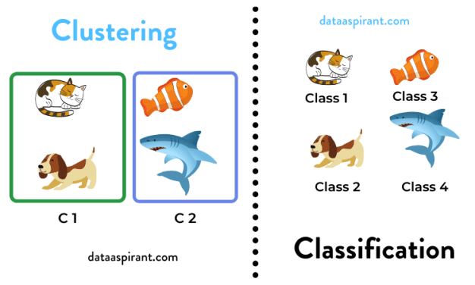
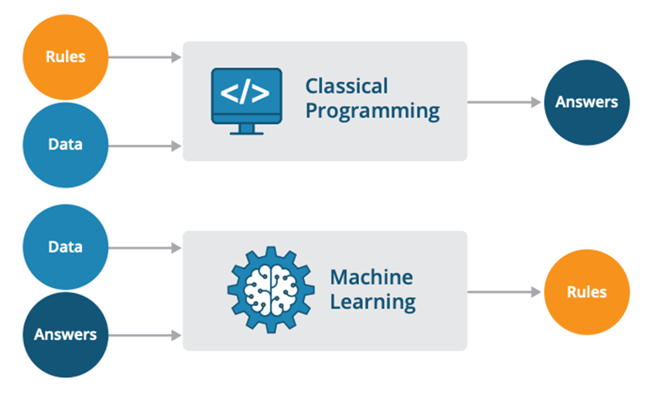
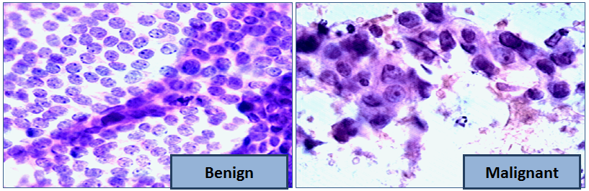
Background
1. Access and Load data
Why Machine Learning and How?
2. Preprocess
2 x 3 = ?
3. Derive Features
4. Model Training
2 ? 2 = 4
5. Model Tuning
x, +, ∫, exp
6. Result
Unsupervised ML
(Unlabeled data)
Supervised ML
(Labeled data)
Data Set
Machine Learning Workflow
Breast Cancer Wisconsin (Diagnostic) Data Set
https://www.kaggle.com/datasets/uciml/breast-cancer-wisconsin-data
Size- 569 Cancer Sample
Class/ Data Labeling: 2 classes, Benign (B), and Malignant (M)
Class Distribution: Benign (62.74%), and Malignant (37.26 %)
Attributes: 32, clean text (string), category (numeric)
mj71006@uga.edu

Slide 4
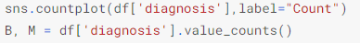
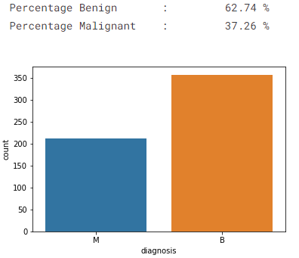
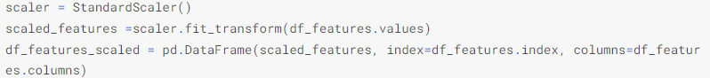
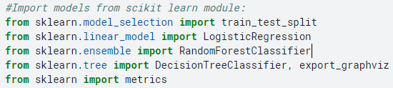
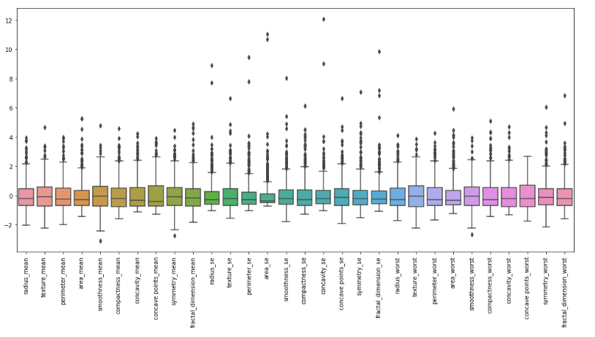
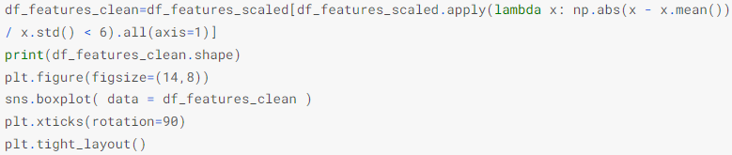
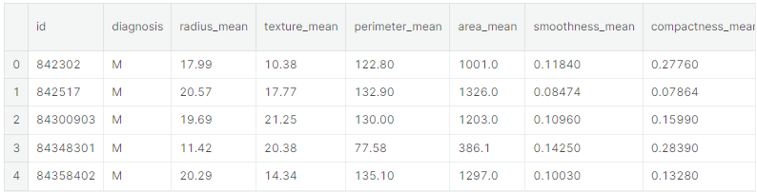
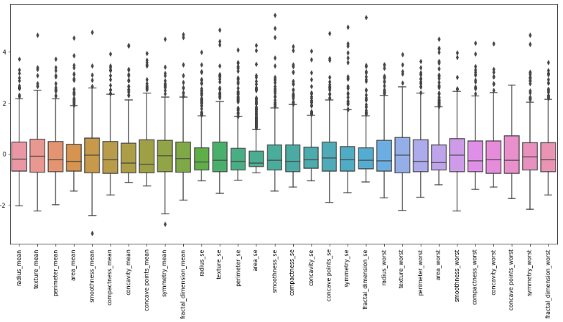
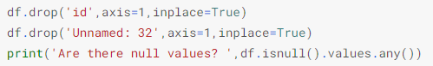
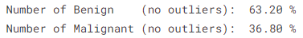
b) Check Data Distribution
ML Workflow
c) Remove outliers
1. Load the packages
Outliers
2. Access and Load data
Remove Outliers
No Outliers
3. Preprocess
a) Drop Null, Repetitive, or, unusual data
mj71006@uga.edu

Slide 5
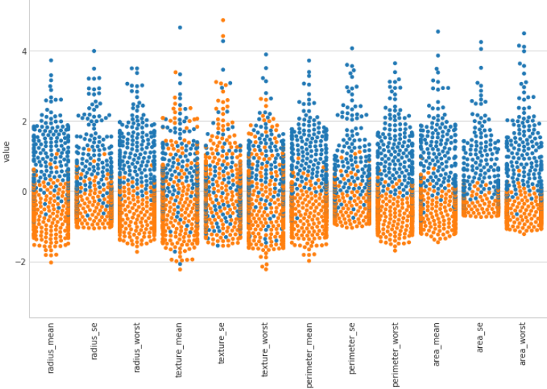
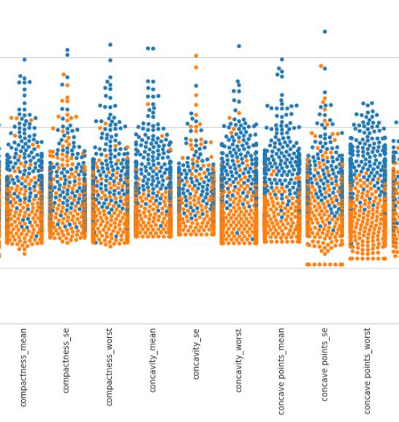
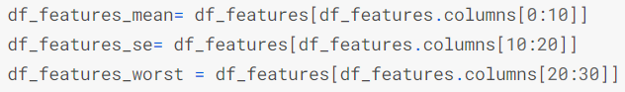
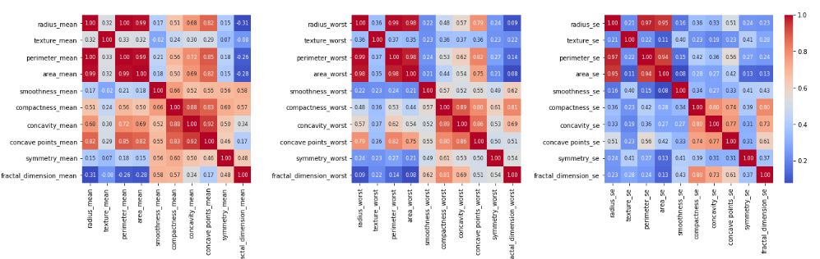
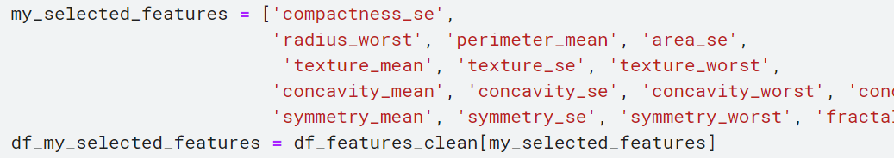
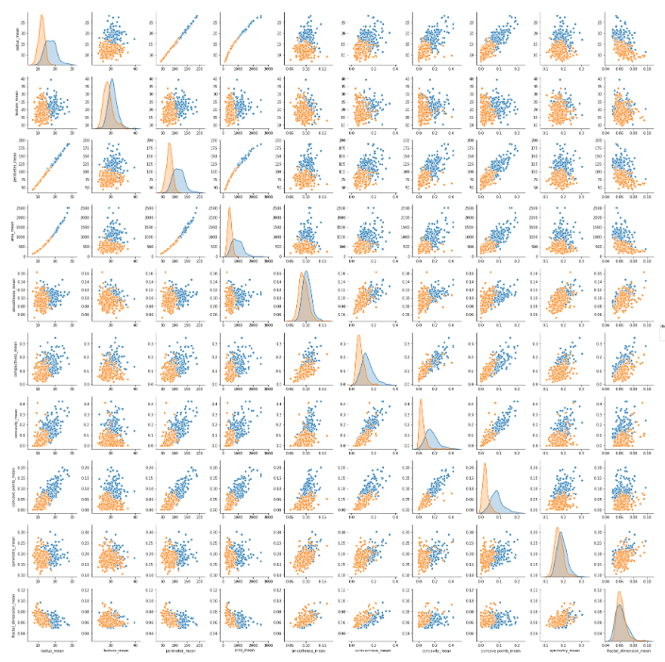
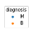
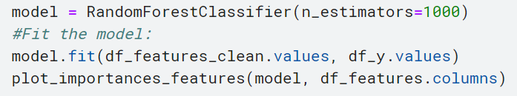
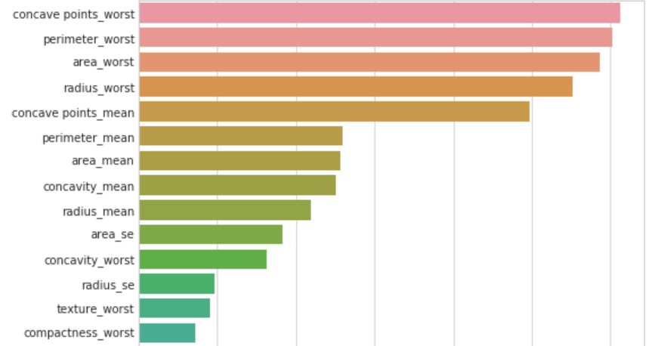
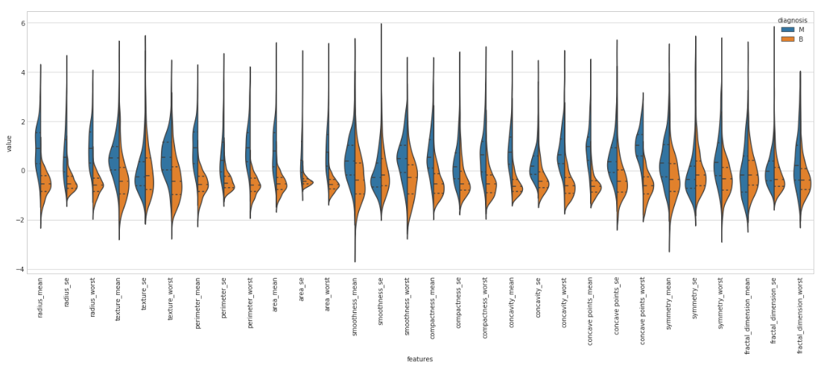
b) Choose the Correct Feature
ML Workflow (Cont.)
4. Feature Engineering
a) Check Data Correlation
Swarm plots
Select the features that are most discriminating (swarm plot) among the most correlated features (correlation plot)
Radius, area, perimeter and
compactness, concave points, and concavity are highly Correlated
c) Selected Feature Ranking
Radius, area, and perimeter have the Binomial
All B cancer smaller area, has Gaussian distribution
Pair plots
mj71006@uga.edu

Slide 6
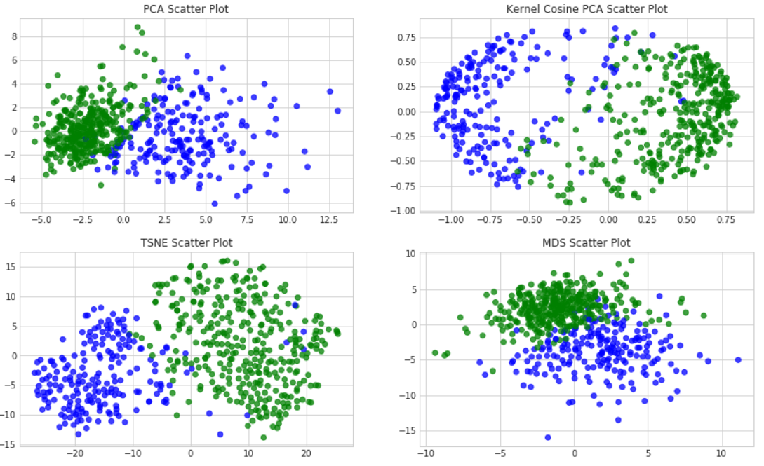
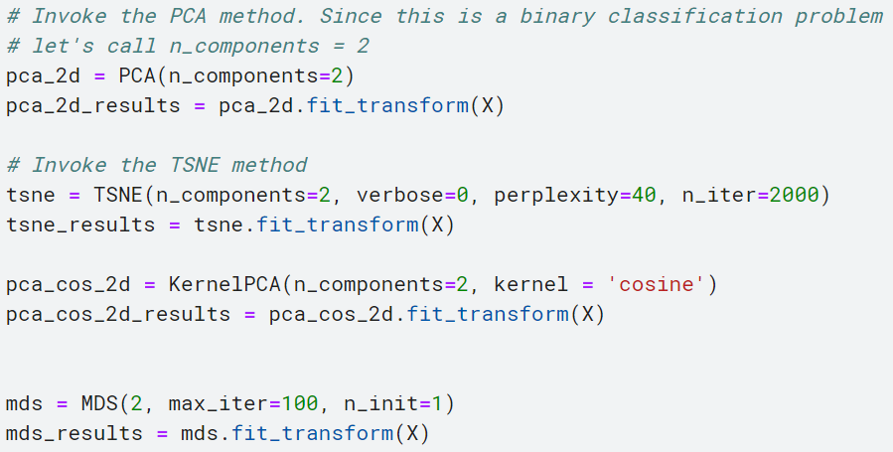
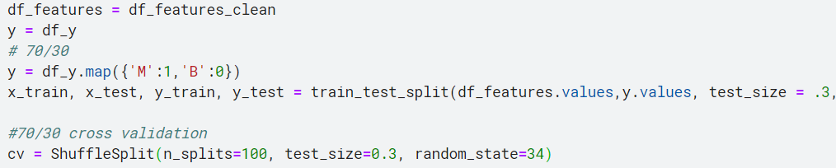
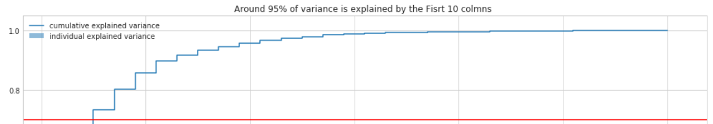
ML Workflow (Cont.)
4. Feature Engineering
d) Dimensionality Reduction
Too many variables
Too complex visualization problems
Decrease efficiency by including variables that has no effect on the analysis
Make data interpretation difficult
Understanding how to simplify the dataset, without losing relevant information → PCA, TSNE, MDS
Select the features that are most discriminating (swarm plot) among the most correlated features (correlation plot)
e) Train, Validation, Test split
Train: Validation: Test: 40%: 30%: 30%
PCA vs. Variance
mj71006@uga.edu

Slide 7
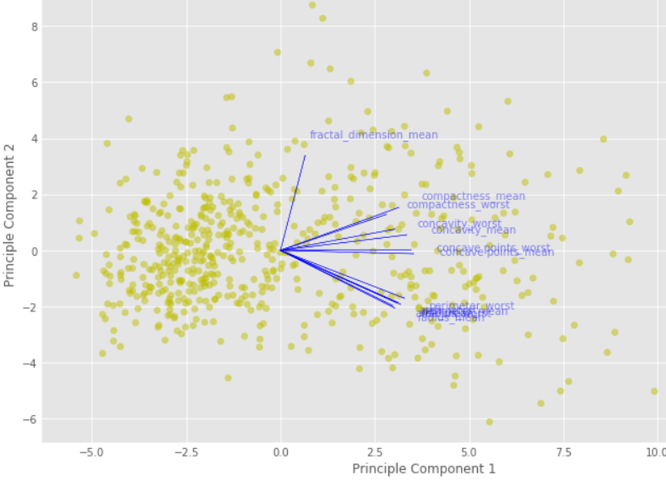
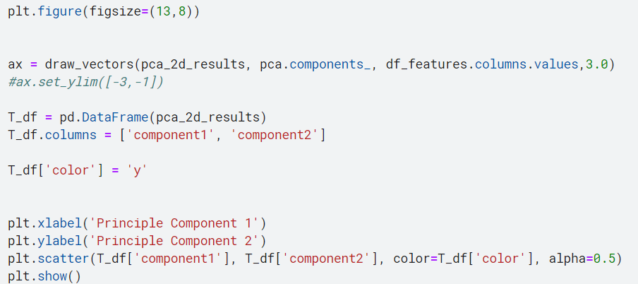
ML Workflow (Cont.)
Feature Space:
mj71006@uga.edu

Slide 8
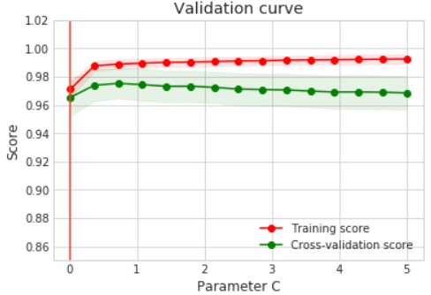
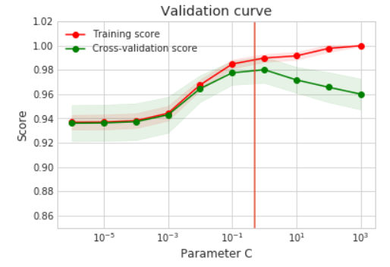
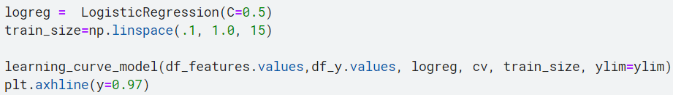
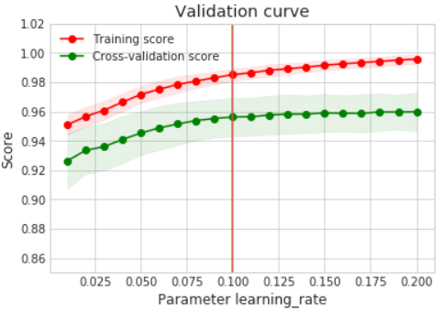
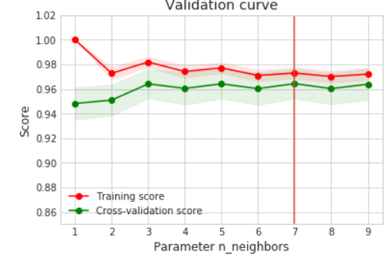
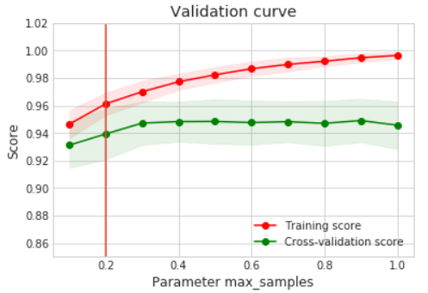
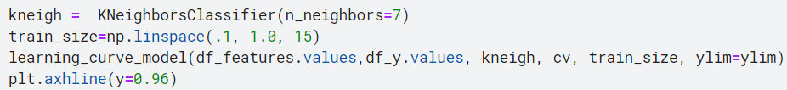
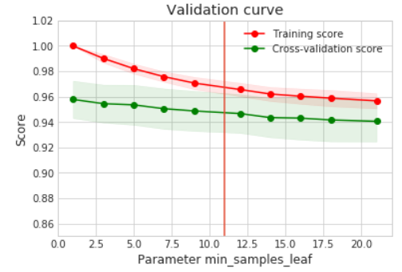
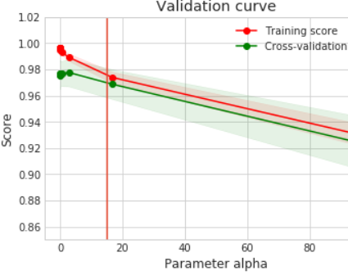
d) Support Vector Classifier
ML Workflow (Cont.)
4. Train the model (Classification)
a) Logistic Regression
e) Adaboost Classifier
e) Bagging Classifier
b) K-NN Classifier
c) Random Forest Classifier
f) MLP Classifier
mj71006@uga.edu

Slide 9
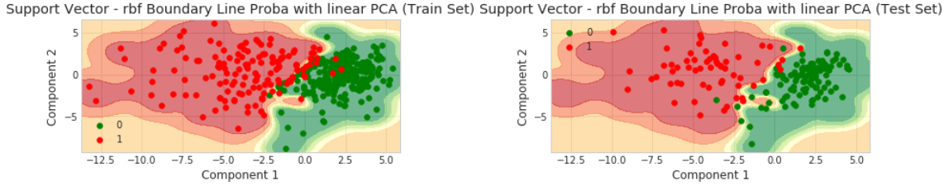
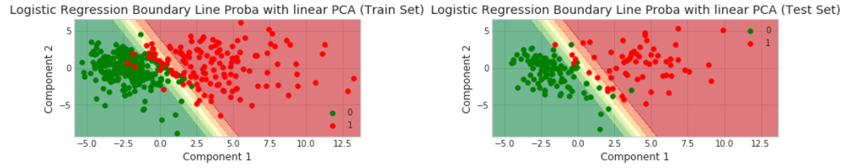
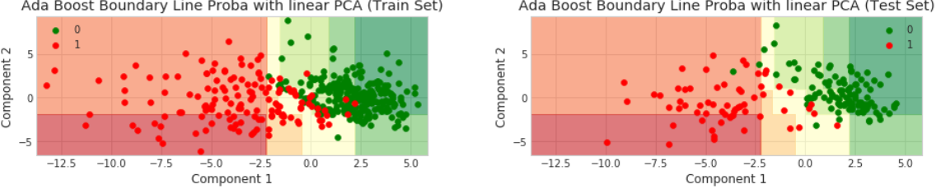
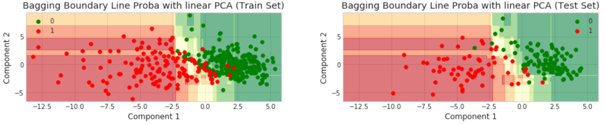
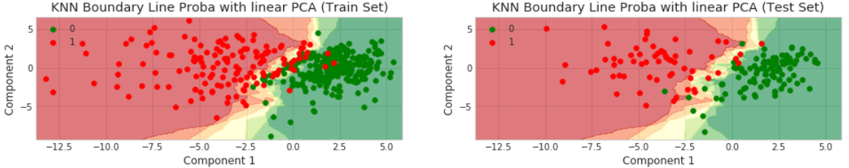
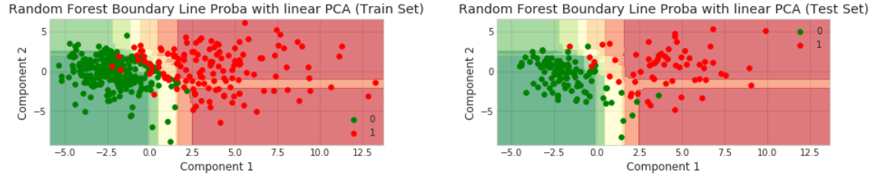
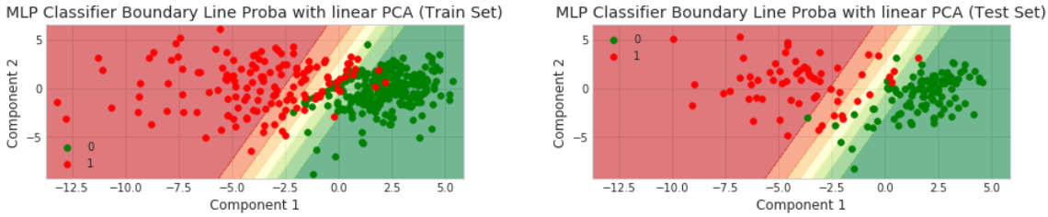
d) Support Vector Classifier
ML Workflow (Cont.)
4. Train the model (Classification)
a) Logistic Regression
e) Adaboost Classifier
e) Bagging Classifier
b) K-NN Classifier
c) Random Forest Classifier
e) MLP Classifier
mj71006@uga.edu

Slide 10
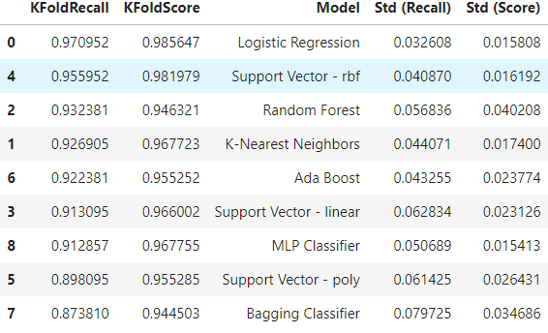
ML Workflow (Cont.)
5. Evaluate the model (Classification)
Classification Comparison:
The winner is Logistic Regression
Which model is the best? How to tune hyper parameters?
So, there is no ultimate best model, by doing proper feature engineering you can beat any renown ML/DL models
mj71006@uga.edu

Slide 11
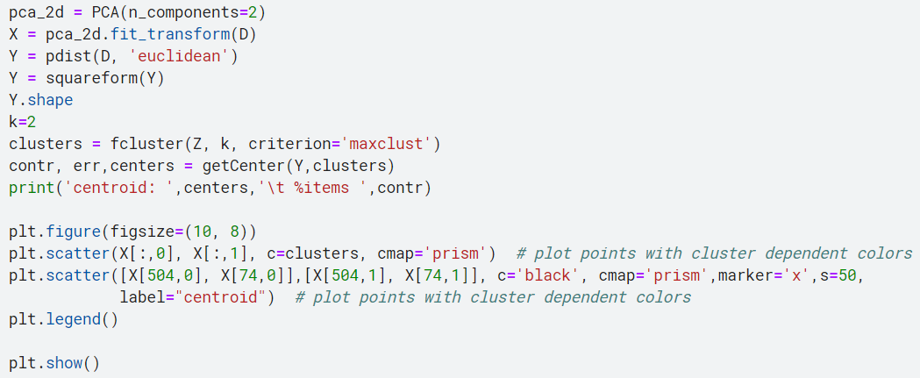
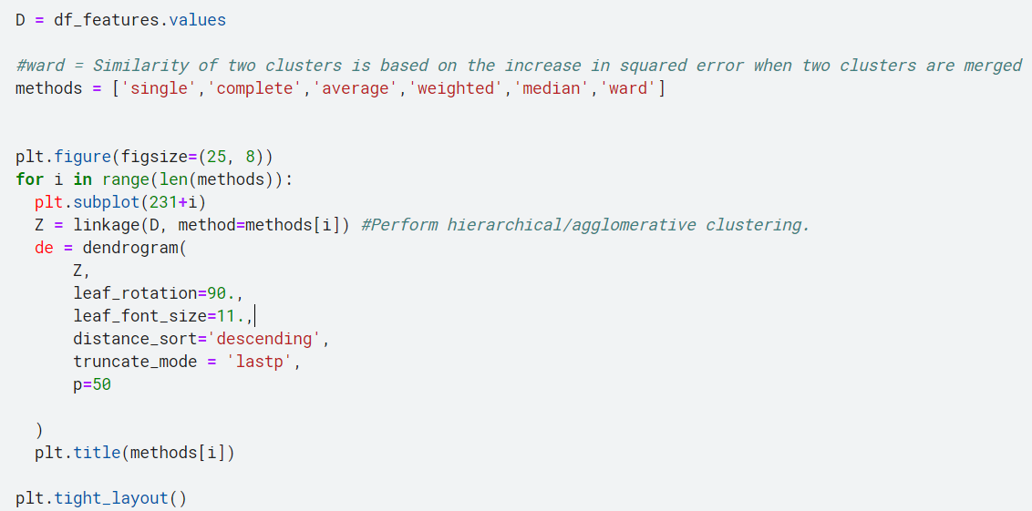
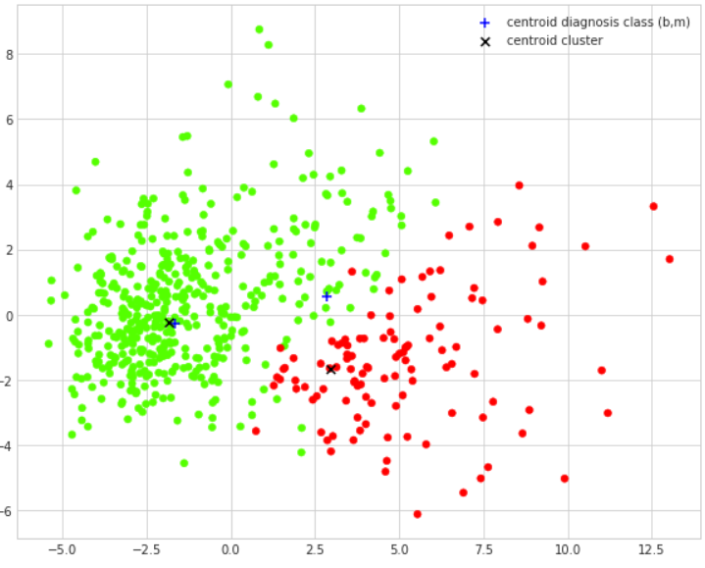
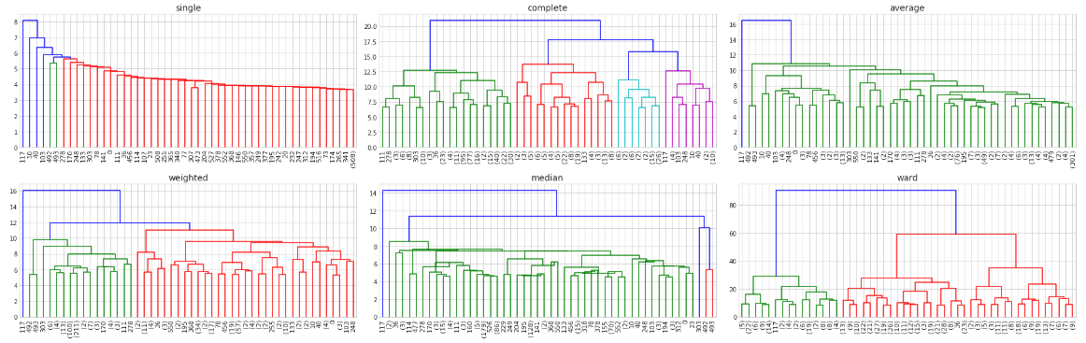
ML Workflow (Cont.)
4.1 Train the model (Clustering)
a) Hierarchical Clustering
How many clusters? What is best clustering that fits my data?
Ward Linkage Method
mj71006@uga.edu

Slide 12





ML Workflow (Cont.)
4.1 and 5.1 Train the model and Evaluate (Clustering)
a) Centroid based Clustering: K-means
How many clusters? What is best clustering that fits my data?
Elbow Method
mj71006@uga.edu

Slide 13
Summary
Explained the exploratory data analysis
Showed how to choose the best feature
Explained the dimensionality reduction
Analyze 7 classification and 2 Clustering algorithm
Accuracy wise Logistic Regression is the winner (98.5%)
Clustering shape and feature wise: K-means is the winner (3-means)
mj71006@uga.edu

Slide 14
Thanks!
Any Question?

